Slide 1

SEARCH STRATEGIES

Slide 2
Building goal-based agents
To build a goal-based agent we need to answer the following questions:
  What is the goal to be achieved?
  What are the actions?
  What relevant information is necessary to encode in order to describe the state of the world, describe the available transitions, and solve the problem?
Initial
state
Goal
state
Actions

Slide 3

What is the goal to be achieved?
Could describe a situation we want to achieve, a set of properties that we want to hold, etc.
Requires defining a “goal test” so that we know what it means to have achieved/satisfied our goal.
Certainly psychologists and motivational speakers always stress the importance of people establishing clear goals for themselves as the first step towards solving a problem.
What are your goals???

Slide 4
What are the actions?
Characterize the primitive actions or events that are available for making changes in the world in order to achieve a goal.
Deterministic world: no uncertainty in an action’s effects. Given an action (a.k.a. operator or move) and a description of the current world state, the action completely specifies
  whether that action can be applied to the current world (i.e., is it applicable and legal), and
  what the exact state of the world will be after the action is performed in the current world (i.e., no need for “history” information to compute what the new world looks like).

Slide 5
Representing actions
Note also that actions in this framework can all be considered as discrete events that occur at an instant of time.
  For example, if “Mary is in class” and then performs the action “go home,” then in the next situation she is “at home.” There is no representation of a point in time where she is neither in class nor at home (i.e., in the state of “going home”).
The number of actions / operators depends on the representation used in describing a state.
  In the 8-puzzle, we could specify 4 possible moves for each of the 8 tiles, resulting in a total of 4*8=32 operators.
  On the other hand, we could specify four moves for the “blank” square and we would only need 4 operators.
Representational shift can greatly simplify a problem!
Notes:
The representational shift hypothesis (Lupyan, 2008) suggests that when explicit labels are used while perceiving an object, the encoded representation shifts from what it would be without explicit labeling to a more prototypical representation.

Slide 6
Representing states
What information is necessary to encode about the world to sufficiently describe all relevant aspects to solving the goal? That is, what knowledge needs to be represented in a state description to adequately describe the current state or situation of the world?
The size of a problem is usually described in terms of the number of states that are possible.
  Tic-Tac-Toe has about 3⁹ states.
  Checkers has about 10⁴⁰ states.
  Rubik’s Cube has about 10¹⁹ states.
  Chess has about 10¹²⁰ states in a typical game.

Slide 7
Closed World Assumption
We will generally use the Closed World Assumption.
All necessary information about a problem domain is available in each percept so that each state is a complete description of the world.
There is no incomplete information at any point in time.

Slide 8
Some example problems
Toy problems and micro-worlds
  8-Puzzle
  Missionaries and Cannibals
  Remove 5 Sticks
Real-world problems

Slide 9
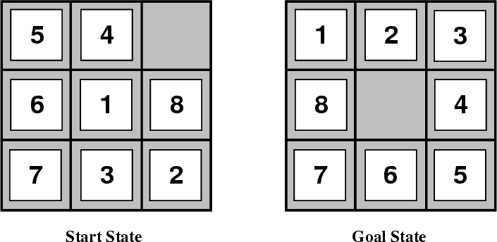
8-Puzzle
Given an initial configuration of 8 numbered tiles on a 3 x 3 board, move the tiles in such a way so as to produce a desired goal configuration of the tiles.

Slide 10
8 puzzle
State: 3 x 3 array configuration of the tiles on the board.
Operators: Move Blank Square Left, Right, Up or Down.
  This is a more efficient encoding of the operators than one in which each of four possible moves for each of the 8 distinct tiles is used.
Initial State: A particular configuration of the board.
Goal: A particular configuration of the board.

Slide 11

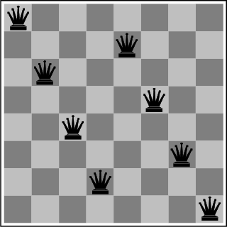
The 8-Queens Problem
Place eight queens on a chessboard such that no queen attacks any other!

Slide 12
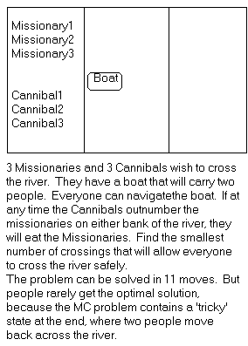
Missionaries and Cannibals
There are 3 missionaries, 3 cannibals, and 1 boat that can carry up to two people on one side of a river.
Goal: Move all the missionaries and cannibals across the river.
Constraint: Missionaries can never be outnumbered by cannibals on either side of river, or else the missionaries are killed.
State: configuration of missionaries and cannibals and boat on each side of river.
Operators: Move boat containing some set of occupants across the river (in either direction) to the other side.

Slide 13
Missionaries and Cannibals Solution
Near side Far side
0 Initial setup: MMMCCC B -
1 Two cannibals cross over: MMMC B CC
2 One comes back: MMMCC B C
3 Two cannibals go over again: MMM B CCC
4 One comes back: MMMC B CC
5 Two missionaries cross: MC B MMCC
6 A missionary & cannibal return: MMCC B MC
7 Two missionaries cross again: CC B MMMC
8 A cannibal returns: CCC B MMM
9 Two cannibals cross: C B MMMCC
10 One returns: CC B MMMC
11 And brings over the third: - B MMMCCC

Slide 14
Remove 5 Sticks
Given the following configuration of sticks, remove exactly 5 sticks in such a way that the remaining configuration forms exactly 3 squares.

Slide 15

Some more real-world problems
Route finding
Touring (traveling salesman)
Logistics
VLSI layout
Robot navigation

Slide 16
Knowledge representation issues
What’s in a state ?
  Is the color of the boat relevant to solving the Missionaries and Cannibals problem? Is sunspot activity relevant to predicting the stock market? What to represent is a very hard problem that is usually left to the system designer to specify.
What level of abstraction or detail to describe the world.
  Too fine-grained and we’ll “miss the forest for the trees.” Too coarse-grained and we’ll miss critical details for solving the problem.
The number of states depends on the representation and level of abstraction chosen.
  In the Remove-5-Sticks problem, if we represent the individual sticks, then there are 17-choose-5 possible ways of removing 5 sticks. On the other hand, if we represent the “squares” defined by 4 sticks, then there are 6 squares initially and we must remove 3 squares, so only 6-choose-3 ways of removing 3 squares.

Slide 17
Formalizing search in a state space
A state space is a graph (V, E) where V is a set of nodes and E is a set of arcs, and each arc is directed from a node to another node.
Each node is a data structure that contains a state description plus other information such as the parent of the node, the name of the operator that generated the node from that parent, and other bookkeeping data.
Each arc corresponds to an instance of one of the operators. When the operator is applied to the state associated with the arc’s source node, then the resulting state is the state associated with the arc’s destination node.

Slide 18
Formalizing search II
Each arc has a fixed, positive cost associated with it corresponding to the cost of the operator.
Each node has a set of successor nodes corresponding to all of the legal operators that can be applied at the source node’s state.
  The process of expanding a node means to generate all of the successor nodes and add them and their associated arcs to the state-space graph
One or more nodes are designated as start nodes.
A goal test predicate is applied to a state to determine if its associated node is a goal node.

Slide 19
Formalizing search III
A solution is a sequence of operators that is associated with a path in a state space from a start node to a goal node.
The cost of a solution is the sum of the arc costs on the solution path.
  If all arcs have the same (unit) cost, then the solution cost is just the length of the solution (number of steps / state transitions)

Slide 20
Formalizing search IV
State-space search is the process of searching through a state space for a solution by making explicit a sufficient portion of an implicit state-space graph to find a goal node.
  For large state spaces, it isn’t practical to represent the whole space.
  Initially V={S}, where S is the start node; when S is expanded, its successors are generated and those nodes are added to V and the associated arcs are added to E. This process continues until a goal node is found.
Each node implicitly or explicitly represents a partial solution path (and cost of the partial solution path) from the start node to the given node.
  In general, from this node there are many possible paths (and therefore solutions) that have this partial path as a prefix.

Slide 21


Key procedures to be defined
EXPAND
  Generate all successor nodes of a given node
GOAL-TEST
  Test if state satisfies all goal conditions
QUEUEING-FUNCTION
  Used to maintain a ranked list of nodes that are candidates for expansion

Slide 22
Bookkeeping
Typical node data structure includes:
  State at this node
  Parent node
  Operator applied to get to this node
  Depth of this node (number of operator applications since initial state)
  Cost of the path (sum of each operator application so far)

Slide 23
Evaluating Search Strategies
Completeness
  Guarantees finding a solution whenever one exists
Time complexity
  How long (worst or average case) does it take to find a solution? Usually measured in terms of the number of nodes expanded
Space complexity
  How much space is used by the algorithm? Usually measured in terms of the maximum size of the “nodes” list during the search
Optimality/Admissibility
  If a solution is found, is it guaranteed to be an optimal one? That is, is it the one with minimum cost?

Slide 24

UNINFORMED SEARCH
Uninformed search?
Uninformed search methods
    Depth-first search
    Breadth-first search
    Iterative deepening search
    Bi-directional search
Notes:
ICS611-Foundations of A.I
Part3.2 -Uninformed search

Slide 25
Uninformed Search?
Simply searches the state space.
Can only distinguish between goal state and non-goal state.
Sometimes called Blind search as it has no information or knowledge about its domain.

Slide 26
Uninformed Search Characteristics
Blind Searches have no preference as to which state (node) that is expanded next.
The different types of blind searches are characterised by the order in which they expand the nodes.
This can have a dramatic effect on how well the search performs when measured against the four criteria we defined earlier.

Slide 27
Uninformed (Blind) Search Methods
Methods that do not use any specific knowledge about the problem.
These are:
  Depth-first search
  Breadth-first search
  Non deterministic search
  Iterative deepening search
  Bi-directional search

Slide 28
1. Depth-first Search
Expand the tree as deep as possible, returning to upper levels when needed.

Slide 29
Depth-First Search

Slide 30
Depth-first search
= Chronological backtracking
S
Select a child
  convention: left-to-right
Repeatedly go to next child, as long as possible.
Return to left-over alternatives (higher-up) only when needed.
A
B
C
E
D
F
G

Slide 31
Depth-first algorithm:
1. QUEUE <-- path only containing the root;
2. WHILE QUEUE is not empty
AND goal is not reached
DO remove the first path from the QUEUE;
create new paths (to all children);
reject the new paths with loops;
add the new paths to front of QUEUE;
3. IF goal reached
THEN success;
ELSE failure;

Slide 32
4
4
3
A
B
C
S
5
5
G
4
3
D
2
E
4
F
1. QUEUE <-- path only containing the root;
2. WHILE QUEUE is not empty
AND goal is not reached
DO remove the first path from the QUEUE;
create new paths (to all children);
reject the new paths with loops;
add the new paths to front of QUEUE;
3. IF goal reached
THEN success;
ELSE failure;

Slide 33
Trace of depth-first for running example:
(S) S removed, (SA,SD) computed and added
(SA, SD) SA removed, (SAB,SAD,SAS) computed, (SAB,SAD) added
(SAB,SAD,SD) SAB removed, (SABA,SABC,SABE) computed, (SABC,SABE) added
(SABC,SABE,SAD,SD) SABC removed, (SABCB) computed, nothing added
(SABE,SAD,SD) SABE removed, (SABEB,SABED,SABEF) computed, (SABED,SABEF)added
(SABED,SABEF,SAD,SD) SABED removed, (SABEDS,SABEDA.SABEDE) computed, nothing added
(SABEF,SAD,SD) SABEF removed, (SABEFE,SABEFG) computed, (SABEFG) added
(SABEFG,SAD,SD) goal is reached: reports success

Slide 34
Evaluation criteria:
Completeness
  Does the algorithm always find a path?
    (for every state space such that a path exits)
Speed (worst time complexity) :
  What is the highest number of nodes that may need to be created?
Memory (worst space complexity) :
  What is the largest amount of nodes that may need to be stored?
Expressed in terms of:
    d = depth of the tree
    b = (average) branching shallowest factor of the tree
    m = depth of the solution

Slide 35
Repeated States problem
In the above discussion we have ignored an important complication that often arises in search processes – the possibility that we will waste time by expanding states that have already been expanded before somewhere else on the search tree.

Slide 36
Avoiding Repeated States
Never return to the state you have just come from
Never create search paths with cycles in them
Never generate states that have already been generated before – store all generated states in memory.

Slide 37
Note: approximations !!
In our complexity analysis, we do not take the built-in loop-detection into account.
The results only ‘formally’ apply to the variants of our algorithms WITHOUT loop-checks.
Studying the effect of the loop-checking on the complexity is hard:
  overhead of the checking MAY or MAY NOT be compensated by the reduction of the size of the tree.
Also: our analysis DOES NOT take the length (space) of representing paths into account !!

Slide 38
Completeness (depth-first)
Complete for FINITE (implicit) NETS.
  (= State space with finitely many nodes)
IMPORTANT:
  This is due to integration of LOOP-checking in this version of Depth-First (and in all other algorithms that will follow) !
    IF we do not remove paths with loops, then Depth-First is not complete (may get trapped in loops of a finite State space)
Note: does NOT find the shortest path.

Slide 39
4
4
3
A
B
C
S
5
5
G
4
3
D
2
E
F
3
S
4
4
A
D
2
5
5
B
D
A
E
4
5
2
4
5
4
C
2
E
4
5
E
B
B
F
4
4
5
4
4
3
D
F
B
F
C
E
A
C
G
3
4
3
4
G
C
G
F
3
G

Slide 40
Speed (depth-first)
In the worst case:
  the (only) goal node may be on the right-most branch,
d
b
G
Time complexity == b^{d} + b^{d-1} + … + 1 = b^{d+1} -1
Thus: O(b^{d})
b - 1

Slide 41
Memory (depth-first)
Largest number of nodes in QUEUE is reached in bottom left-most node.
Example: d = 3, b = 3 :
...
QUEUE contains all nodes. Thus: 7.
In General: ((b-1) * d) + 1
Order: O(d*b)

Slide 42
2. Breadth-first Search
Expand the tree layer by layer, progressing in depth.
In other words,
    Expand root node first
    Expand all nodes at level 1 before expanding level 2
    OR
    Expand all nodes at level d before expanding nodes at level d+1

Slide 43
Breadth-First Search

Slide 44
Breadth-first search:
S
A
Move downwards, level by level, until goal is reached.
D
B
D
A
E
C
E
E
B
B
F
D
F
B
F
C
E
A
C
G
G
C
G
F
G

Slide 45
Breadth-first algorithm:
1. QUEUE <-- path only containing the root;
2. WHILE QUEUE is not empty
AND goal is not reached
DO remove the first path from the QUEUE;
create new paths (to all children);
reject the new paths with loops;
add the new paths to back of QUEUE;
3. IF goal reached
THEN success;
ELSE failure;
ONLY
DIFFERENCE !

Slide 46
Trace of breadth-first for running example:
(S) S removed, (SA,SD) computed and added
(SA, SD) SA removed, (SAB,SAD,SAS) computed, (SAB,SAD) added
(SD,SAB,SAD) SD removed, (SDA,SDE,SDS) computed, (SDA,SDE) added
(SAB,SAD,SDA,SDE) SAB removed, (SABA,SABE,SABC) computed, (SABE,SABC) added
(SAD,SDA,SDE,SABE,SABC) SAD removed, (SADS,SADA, SADE) computed, (SADE) added
etc, until QUEUE contains:
(SABED,SABEF,SADEB,SADEF,SDABC,SDABE,SDEBA,SDEBC, SDEFG) goal is reached: reports success

Slide 47
Completeness (breadth-first)
Complete
  even for infinite implicit NETS !
Would even remain complete without our loop-checking.
Note: ALWAYS finds the shortest path.

Slide 48
Speed (breadth-first)
If a goal node is found on depth m of the tree, all nodes up till that depth are created.
m
d
b
G
Thus: O(b^{m})
note: depth-first would also visit deeper nodes.
Notes:
ICS611-Foundations of A.I
Part3.2 -Uninformed search

Slide 49
Memory (breadth-first)
Largest number of nodes in QUEUE is reached on the level m of the goal node.
m
d
b
G
QUEUE contains all and nodes. (Thus: 4) .
In General: b^{m}
This usually is MUCH worse than depth-first !!
G

Slide 50
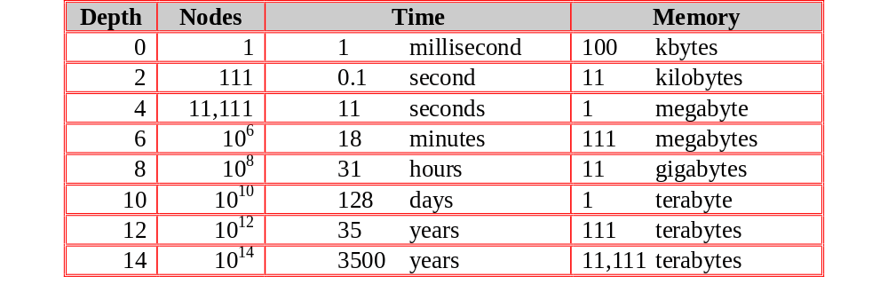
Exponential Growth (breadth-first)
Time and memory requirements for breadth-first search, assuming a branching factor of 10, 100 bytes per node and searching 1000 nodes/second

Slide 51
Exponential Growth - Observations
Space is more of a factor to breadth first search than time
Time is still an issue. Who has 35 years to wait for an answer to a level 12 problem (or even 128 days to a level 10 problem)
It could be argued that as technology gets faster then exponential growth will not be a problem. But even if technology is 100 times faster we would still have to wait 35 years for a level 14 problem and what if we hit a level 15 problem!

Slide 52
Practical evaluation:
1.Depth-first search:
  IF the search space contains very deep branches without solution, THEN Depth-first may waste much time in them.
2. Breadth-first search:
  Is VERY demanding on memory !
Solutions ??
  Non-deterministic search
  Iterative deepening

Slide 53
Non-deterministic search:
1. QUEUE <-- path only containing the root;
2. WHILE QUEUE is not empty
AND goal is not reached
DO remove the first path from the QUEUE;
create new paths (to all children);
reject the new paths with loops;
add the new paths in random places in QUEUE;
3. IF goal reached
THEN success;
ELSE failure;

Slide 54
3. Iterative deepening Search
Restrict a depth-first search to a fixed depth.
If no path was found, increase the depth and restart the search.

Slide 55
Depth-limited search:
1. DEPTH <-- <some natural number>
QUEUE <-- path only containing the root;
2. WHILE QUEUE is not empty
AND goal is not reached
DO remove the first path from the QUEUE;
IF path has length smaller than DEPTH
create new paths (to all children);
reject the new paths with loops;
add the new paths to front of QUEUE;
3. IF goal reached
THEN success;
ELSE failure;

Slide 56
Iterative deepening algorithm:
1. DEPTH <-- 1
2. WHILE goal is not reached
DO perform Depth-limited search;
increase DEPTH by 1;

Slide 57
Iterative deepening: the best ‘blind’ search.
Complete: yes - even finds the shortest path (like breadth first) .
Memory: b*m (combines advantages of depth- and breadth-first)
Speed:
  If the path is found for Depth = m, then how much time was wasted constructing the smaller trees??
b^{m-1} + b^{m-2} + … + 1 = b^{m} -1 = O(b^{m-1})
b - 1
While the work spent at DEPTH = m itself is O(b^{m})
In general: VERY good trade-off

Slide 58
4. Bi-directional Search
Compute the tree from the start node and from a goal node, until these meet.

Slide 59
Bi-directional search
IF you are able to EXPLICITLY describe the GOAL state, AND
you have BOTH rules for FORWARD reasoning AND BACKWARD reasoning:
Start
Goal

Slide 60
Bi-directional algorithm:
1. QUEUE1 <-- path only containing the root;
QUEUE2 <-- path only containing the goal;
2. WHILE both QUEUEs are not empty
AND QUEUE1 and QUEUE2 do NOT share a state
DO remove their first paths;
create their new paths (to all children);
reject their new paths with loops;
add their new paths to back;
3. IF QUEUE1 and QUEUE2 share a state
THEN success;
ELSE failure;

Slide 61
Properties (Bi-directional):
Complete: Yes.
Speed: If the test on common state can be done in constant time (hashing):
  2 * O(b^{m/2}) = O(b^{m/2})
Memory: similarly: O(b^{m/2})

Slide 62
Disadvantage of BDS
We don't really know the solution, only a description of it.
There may be many solutions, and we have to choose some to work backwards from.
We cannot reverse our operators to work backwards from the solution.
We have to record all the paths from both sides to see if any two meet at the same point - this may take up a lot of memory, and checking. Requires a lot of computational power.

Slide 63

INFORMED SEARCH
Informed search?
Informed search methods
    Best-first search
    Greedy search
    A*Search
    A* Variants
Notes:
ICS611-Foundations of A.I
Part3.2 -Uninformed search

Slide 64
INFORMED SEARCHES
Informed search uses some kind of evaluation function to tell us how far each expanded state is from a goal state, and/or some kind of heuristic function to help us decide which state is likely to be the best one to expand next.
Goal:
  To see how information about the state space can prevent algorithms from stumbling in the dark

Slide 65
Heuristic Functions
A heuristic search may use a heuristic function, which is a calculation to estimate how costly (in terms of the path cost) a path from a state will be to a goal state.
Heuristic functions can be derived in a number of ways;

Slide 66
Cont.
  Mathematically
  Think them up as good ideas
  Identify common elements in various search solutions, and convert these to useful heuristic functions.
  Use of computer programs to derive heuristic functions. E.g. ABSOLVER program.

Slide 67
Heuristic Search Strategies
Uniform Path Cost Search
  Similar to a BFS
  A uniform path cost search chooses which node to expand by looking at the path cost for each node: the node which has least cost to get to is expanded first.
  It is an optimal search strategy. It is guaranteed to find the least expensive goal.

Slide 68
Best-first search
= An instance of TREE/GRAPH-SEARCH algorithm
Expand the most desirable node:
Expand node n based on an evaluation function, f(n)
f(n) measures distance to the goal
  Select the node with the lowest f(n)
Fringe implementation:
  Priority queue
    = data structure that will maintain the fringe in ascending order of f-values
Expand what “appears” to be best (according to f), not really the best node
  Unless f is indeed accurate, then it truly is “best”

Slide 69
Best-First Search Algorithms
Different evaluation functions
Heuristic function: h(n)
  Estimated cost of the cheapest path from node n to a goal node.
E.g. Holiday in Romania
  h = the straight distance Arad-Bucharest
Assumption:
  If n=goal node, then h(n)=0
Two Best-first search algorithms:
  Greedy best-first search
  A* search

Slide 70
Greedy Best-First Search
A.k.a. “greedy search” or “best-first search”
Method:
  Expand the node that appears to be closest to the goal
    i.e. it is likely to lead to a solution quickly
  Evaluate nodes using just the heuristic function:
    f(n) = h(n)
Example: Holiday in Romania
  Heuristic (h): straight-line distance
    h_{SLD}(n) = straight-line distance from n to Bucharest

Slide 71
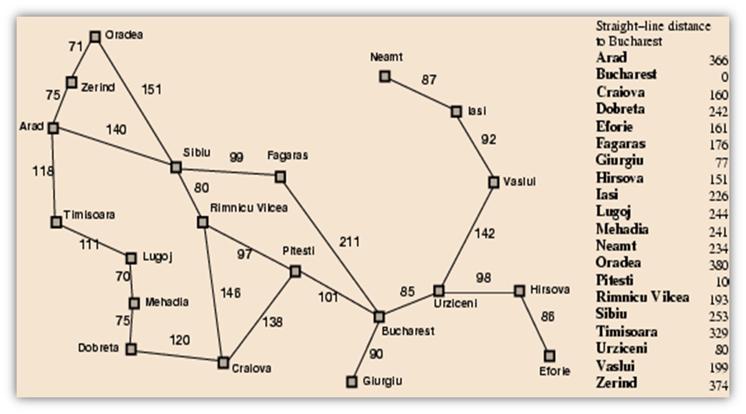
Romania with step costs in km

Slide 72

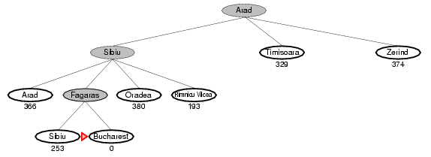
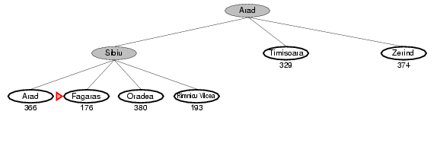
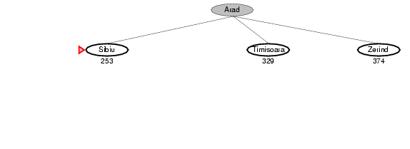
Visualization of Greedy Search

Slide 73
Issues with Greedy Search
False starts
  Because of minimizing h(n)
    E.g. Consider Iaşi → Făgărăşi
      Neamţ = to be expanded first; → dead end
Repeated states
  If they are not avoided → the solution will never be found (infinite loops)
    E.g. same as above:
      Iaşi → Neamţ → Iaşi → Neamţ → …
Resembles DFS (follow one path to the goal)
Same defects as DFS:
  Not optimal, incomplete
    Complete if unique states and finite search space

Slide 74
Cont.
One way to counteract this false start (blind-alley) effect is to turn off the heuristics until a proportion of the search space has been covered, so that the truly high scoring states can be identified.

Slide 75
A*Search
A* search combines the best parts of uniform cost search, namely the fact that it's optimal and complete, and the best parts of greedy search, namely its speed.

Slide 76
A* Search
Goal:
  Minimize the total estimated solution cost
Evaluation function:
  f(n) = g(n) + h(n)
    g(n) = the cost to reach n
    h(n) = the estimated cost from n to the goal node
  f(n) = estimated cost of the cheapest solution through n
Minimize g(n) + h(n)
A* = optimal & complete

Slide 77
Admissible Heuristic
A heuristic h(n) is admissible if:
  h(n) never overestimates the cost to reach the goal, i.e. it is optimistic
A heuristic h(n) is admissible if for every node n,
h(n) ≤ h*(n), where h*(n) is the true cost to reach the goal state from n.
Also require h(n)≥0, so h(G)=0 for any goal G
    h_{SLD}(n) never overestimates the actual road distance

Slide 78
Romania with step costs in km

Slide 79

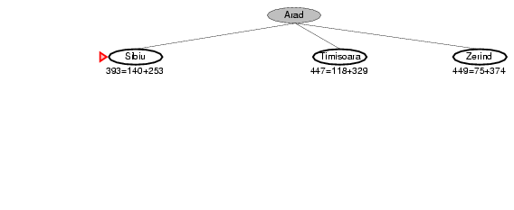
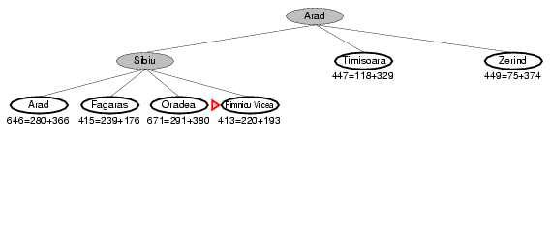
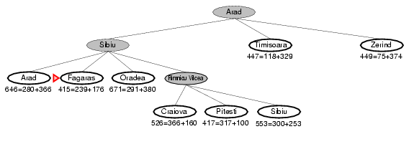
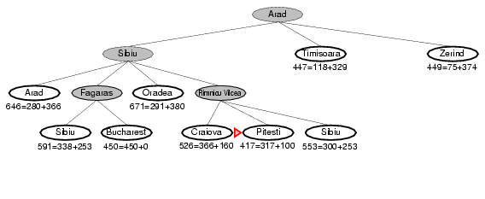
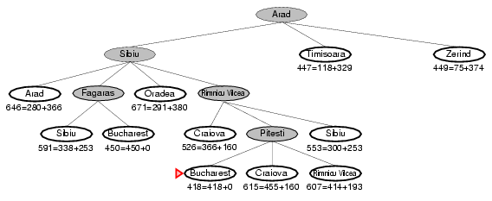
Visualization of A* Search
Slide <number>

Slide 80
Recap….
In which we see how an agent can find a sequence of actions that achieves its goals, when no single action will do.
    Stuart Russell and Peter Norvig
Focus is on problem solving agents – decide what to do by finding sequences of actions that lead to desirable states.
The process of looking for such a sequence is called Search.

Slide 81
Overview of AI Work
Most AI work can be explained as follows;
  Specifying a problem
  Defining a search space with the solution
  Selecting a search strategy
  Choosing an agent to implement the strategy.

Slide 82
Definition of a Problem in AI
  A problem is a specific task where the agent starts with the environment in a given state and acts upon the environment until the altered state has some pre-determined quality
  Class definition?

Slide 83
Types of Problems
There are essentially 4 types of problems;
  Single state problems – the action sequence is a 1 step transition.
  [a1(initial state) to a2(goal state)]

Slide 84
Cont. of problem types
Multiple State Problems
From the initial state, there are a number of action sequences.
Consists of many intermediate states before the goal state.

Slide 85
Cont.
Contingency Problems
Many of the problems in the real world are contingency problems because making an exact prediction is impossible. The environment is partially observable or the actions are uncertain.
Example;
  Keep your eyes open while walking
  Beware! Have your senses awake

Slide 86
Cont.
Exploration Problem
The agent has no information about the effects of its actions e.g. an intelligent agent in a strange city must gradually discover what its actions do and what states exist.

Slide 87
Important Terms
States
  “Places” where the search can visit
Search space
  The set of possible states
Search path
  The states which the search agent actually visits
Solution
  A state with a particular property that solves the problem (achieves the task) at hand
  There may exist more than one solution to a problem
Strategy
  How to choose the next state in the path at any given state

Slide 88
Search Problem considerations
Consider the following when specifying a search problem;
  Initial state
    Inform the agent where the search begins e.g. a city
  Operator set
    Description of the possible actions available to the agent e.g. functions that change one state to another
    Specify how the agent can move around search space
    Final search strategy boils down to choosing states & operators

Slide 89
Cont.
  Goal test
    Describes how the agent knows if the solution (goal) has been achieved.
  Path Cost
    This is a function that assigns a numeric cost to each path. The problem solving agent chooses a cost function that reflects its own performance measure i.e. time, distance etc.

Slide 90
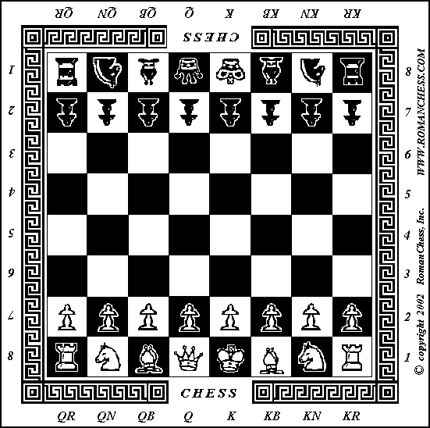
Formulating Problems:
Example 1 - Chess
Initial state
  As in picture
Operators
  Moving pieces
Goal test
  Checkmate
    king cannot move
    without being taken

Slide 91
Example 2 – Route Planning
Initial state
    City the journey starts in
Operators
    Driving from city to city
Goal test
    Destination city

Slide 92
Properties of Search Algorithms
Consider the following when selecting an algorithm;
  Completeness – Is a solution guaranteed to be found if at least one solution exists?
  Optimality – Is the solution found guaranteed to be the best (or lowest cost) solution if there exists more than one solution?

Slide 93
Cont. of Search Properties
  Time Complexity – The upper bound on the time required to find a solution, as a function of the complexity of the problem.
  - How long does it take to find the solution?
  Space Complexity – The upper bound on the storage space (memory) required at any point during the search, as a function of the complexity of the problem.
  - what are the memory requirements?

Slide 94
TREES
These are state graphs that have no cycles in them.
Many AI searches can be represented as Trees.
The root of the tree represents the search node corresponding to the initial state.
The Leaf nodes correspond to all the other possible states in the problem.

Slide 95

Reading Assignment
Read on the IDA* search
MA* search (memory bounded A*)
SMA* (Simplified Memory-Bounded A*) search
Source:
Artificial Intelligence: A Modern Approach, Russell SJ & Norvig P, Prentice-Hall Inc. 1995.

Slide 96

See you next session!

